Slide 1

NETWORK PROGRAMMING ProJECT P2P Chat APPlication
Group 13
nguyen duc hung - 20176779
Nguyen manh khang - 20176792

Slide 2
COntentS
INTRODUCTION
ARCHITECHTURAL DESIGN
DATA MODELING
MESSAGE EXCHANE MODEL
SERVER & CLIENT STRUCTURE
GRAPHICAL USER INTERFACE
INDIVIDUAL CONTRIBUTION
DEMONSTRATION

Slide 3
INTRODUCTION

Slide 4
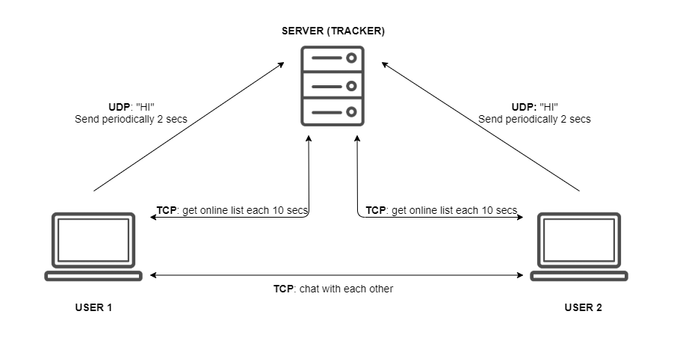
Brief overview

Slide 5
Network programming techniques
TCP
UDP
Multithreading
Multiplexing
Non-blocking IO

Slide 6
ARCHITECTURAL DESIGN

Slide 7
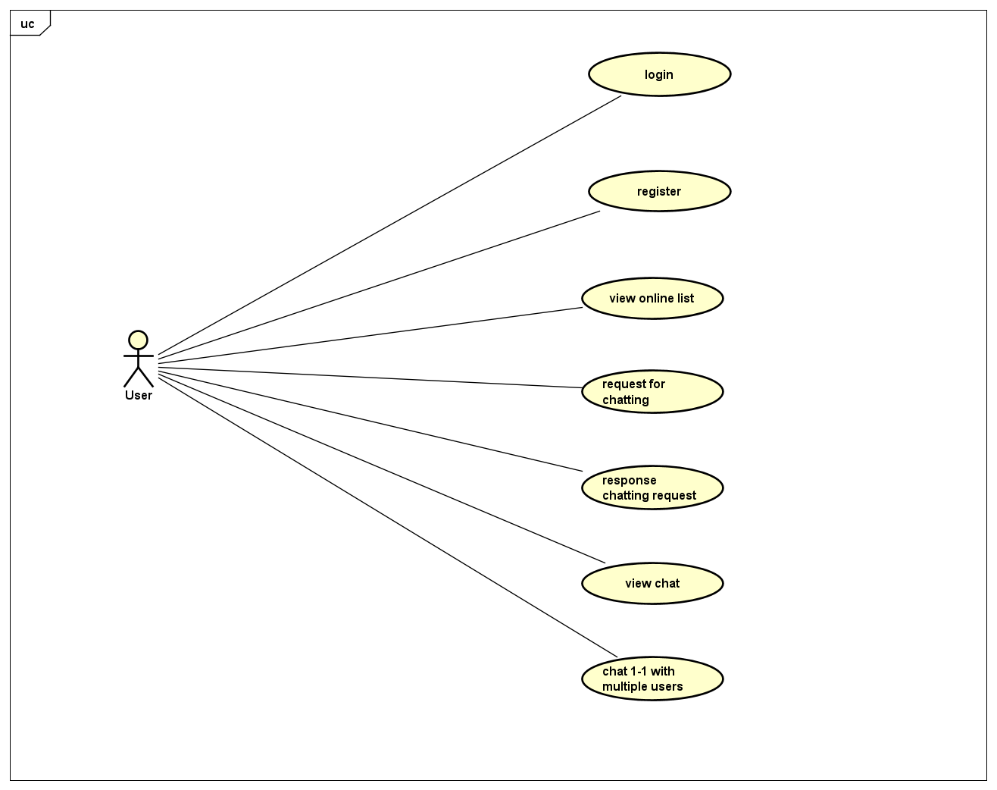
USECASE

Slide 8
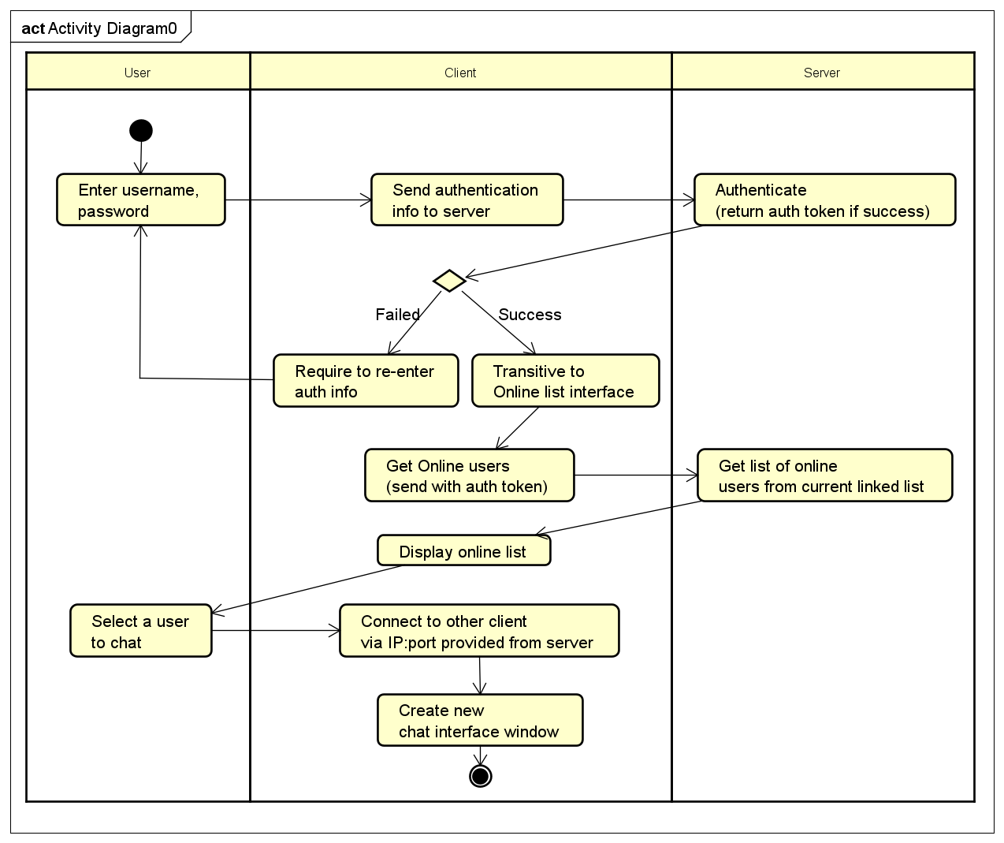
BASIC ACTIVITY

Slide 9
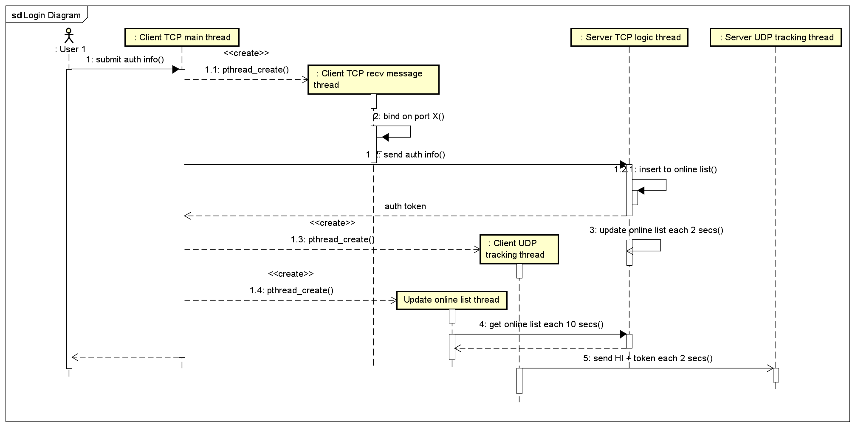
INTERACTION DIAGRAM

Slide 10
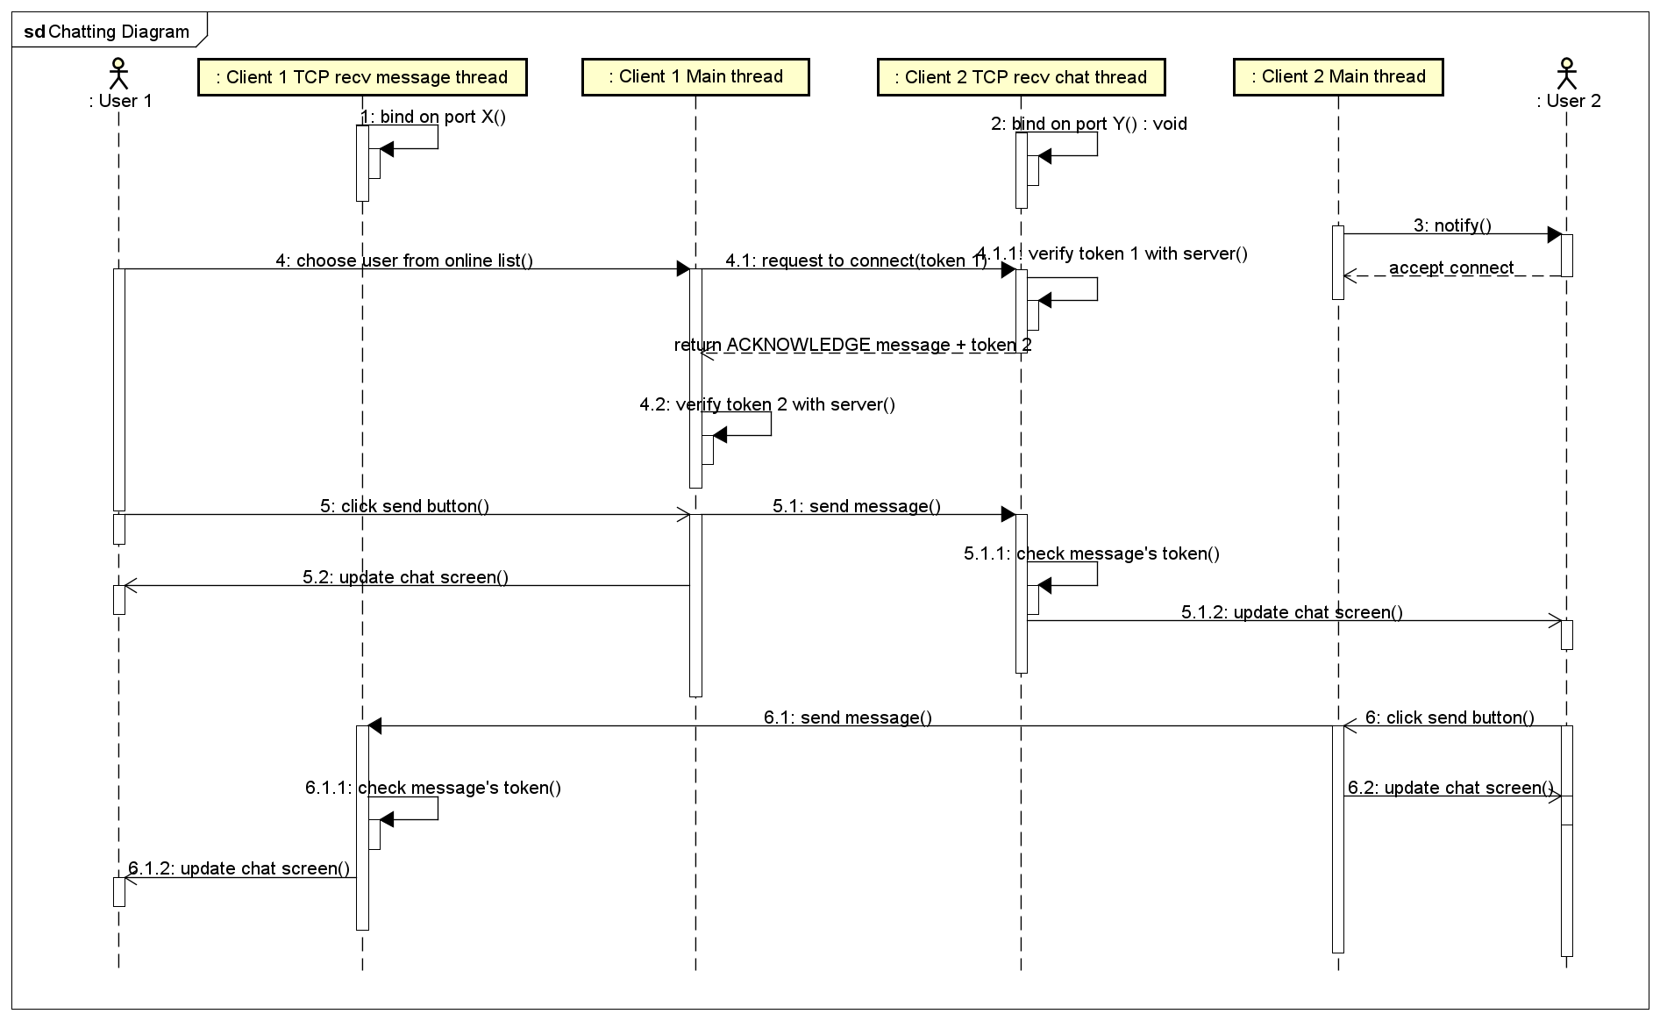
INTERACTION DIAGRAM

Slide 11
DaTA MODELING

Slide 12
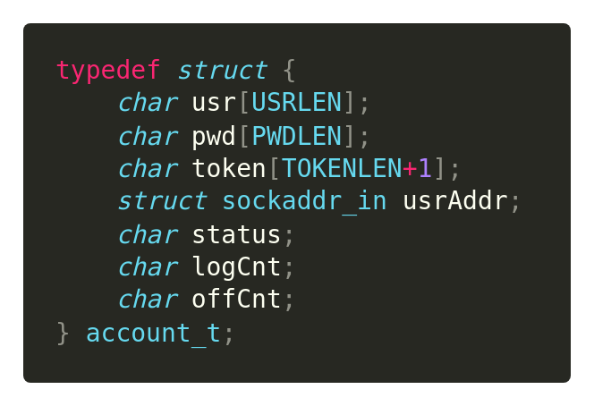
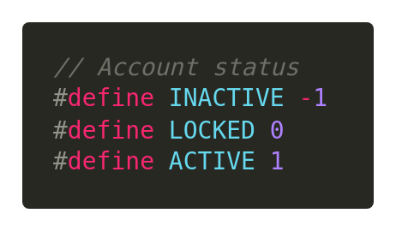
DATA Structure
Structure to manage user
+ usr : username
+ pwd : password
+ token : for authentication
+ usrAddr : address of peer
+ status : account status (see below)
+ logCnt : login attempt count
+ offCnt : offline interval time count

Slide 13
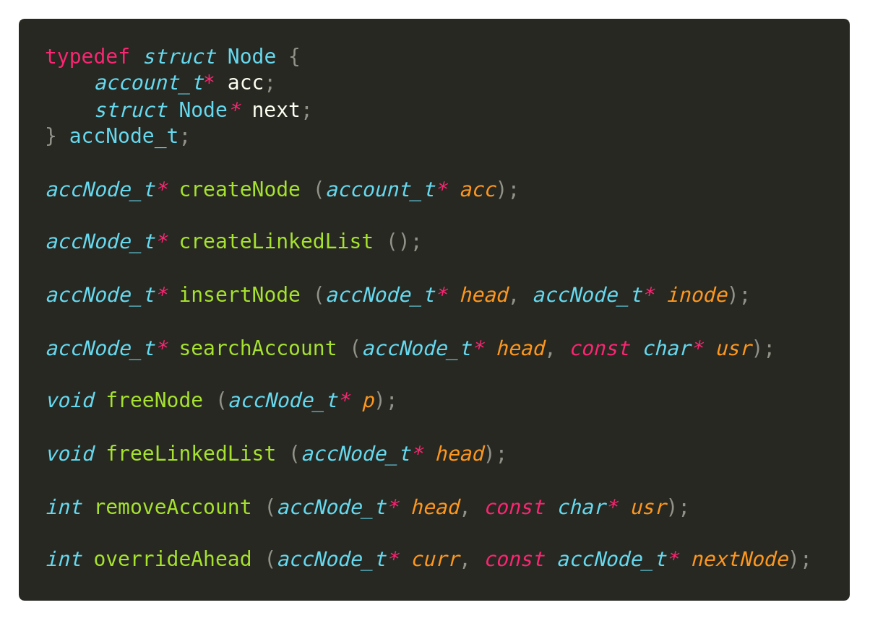
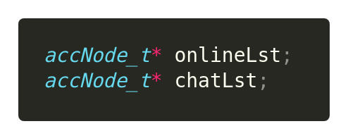
DATA Structure
Notes:
Accounts are organized into a linked list.
+ Online list: online account
+ Chat list: list of chatting user
Why linked list? -> easily to remove. Search operation can be optimized
-> Use a SQL database like SQLite, MySQL instead is much more optimize, but for demo purpose, we decide to use a simple data structure and storage instead

Slide 14
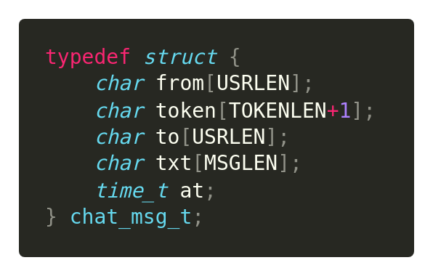
DATA Structure
Structure to manage chat message
+ from : username of sender
+ token : token of sender
+ to : username of receiver
+ txt : chat message
+ at : send time
Notes:
Receiver will compare the given token with stored token of sender to authenticate

Slide 15
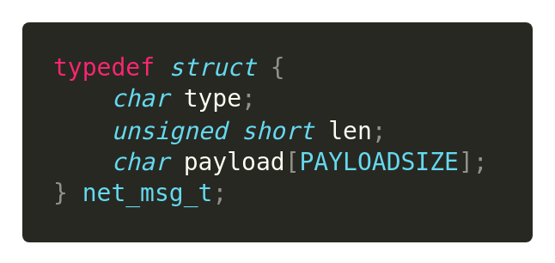
DATA Structure
Structure to exchange message over network
+ type : message type
+ len : payload length
+ payload : message content

Slide 16
MESSAGE EXCHANGE MODEL

Slide 17
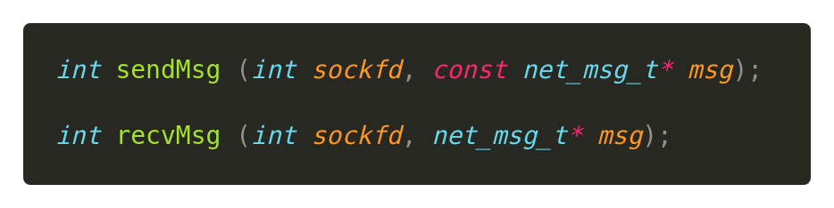
MESSAGE EXCHANGE
Functions to send and receive message over the network
+ sendMsg : caller prepares net_msg_t message to send through sockfd
+ recvMsg : caller have to allocate space for storing network message read in sockfd

Slide 18
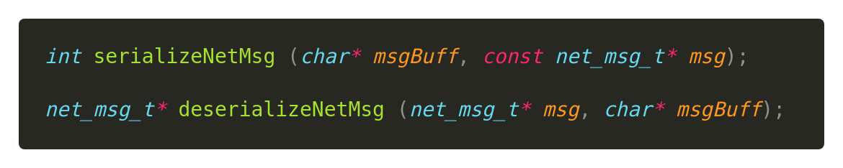
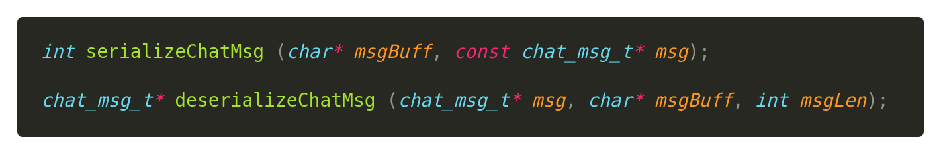
MESSAGE EXCHANGE
Serialize/Deserialize functions
+ Serialize : convert message structure into a formatted memory buffer
+ Deserialize : convert a formatted memory buffer into allocated data structure
Notes:
We need to turn an chat message structure into a buffer to store in net_msg_t.payload, and a network message structure into a memory buffer for easily exchange over network -> solution: serialize at sender, deserialize at receiver
+ Serialize : convert message structure (which is organized by C structure standard) into a formatted memory buffer (which can send through over network without worrying about memory padding, edianess)
+ Deserialize : convert a formatted memory buffer into allocated data structure

Slide 19
CLIENT & SERVER STRUCTURE

Slide 20
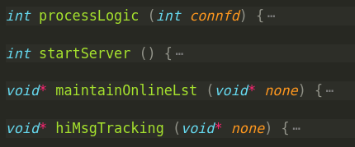
SEVER PROTOTYPE
Server logic of P2P network is simple!
Notes:
startServer: bind and listen to a port
processLogic: receive and handle message (authenticate message, get online list message)
maintainOnlineLst: run on a separate thread to manage online list each time interval
hiMsgTracking: run on a separate thread to receive HI message each time interval

Slide 21
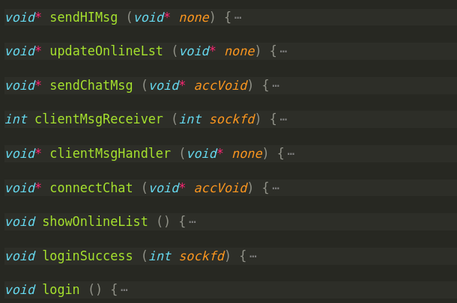
CLIENT PROTOTYPE
Notes:
sendHIMsg: run on a separate thread to send HI msg each time interval
updateOnlineLst: run on a separate thread to retrieve online list each time interval
sendChatMsg: run on a separate thread to send chat message
clientMsgHandler: run on separate thread to receive control message
clientMsgReceiver: run on the same thread with clientMsgHandler (called by clientMsgHandler to read and handle control message)
connectChat: run on a separate thread to request connect to other client
showOnlineList: run on main thread to show online list (called by loginSuccess)
loginSuccess: run on main thread to prepare things when login success (called by login)
Login: run on main thread to do authentication

Slide 22
GRAPHICAL USER INTERFACE

Slide 23

TECHNOLOGY
GTK
+ GTK (formerly GTK+, GIMP ToolKit) is a free and open-source cross-platform widget toolkit for creating graphical user interfaces (GUIs).
+ It is licensed under the terms of the GNU Lesser General Public License, allowing both free and proprietary software to use it.
+ It is one of the most popular toolkits for the Wayland and X11 windowing systems

Slide 24
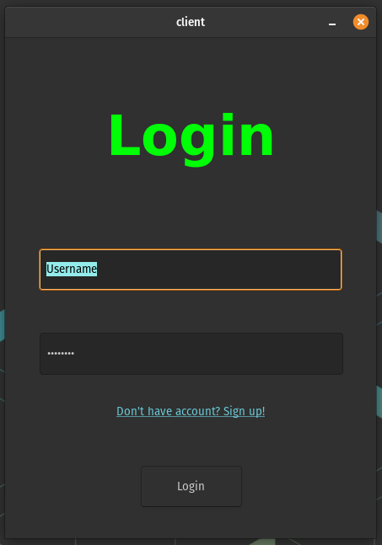
LOGIN SCREEN

Slide 25
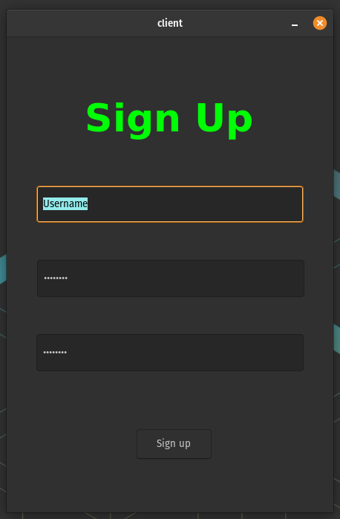
REgister SCREEN

Slide 26
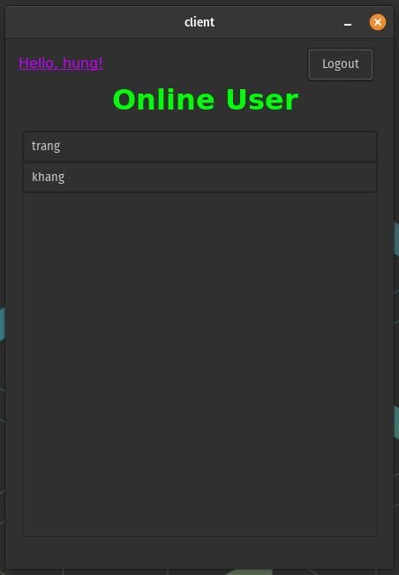
ONLINe list screen

Slide 27
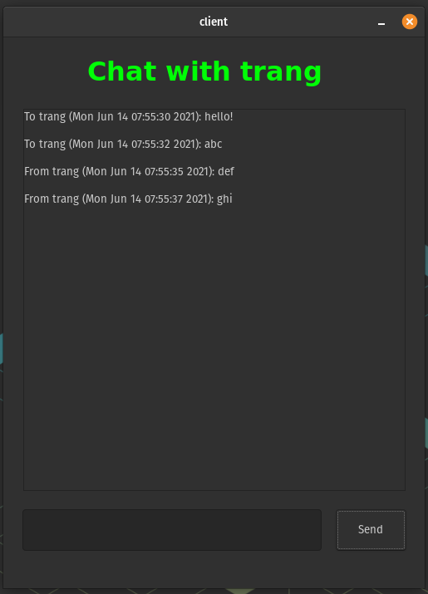
Chat screen

Slide 28
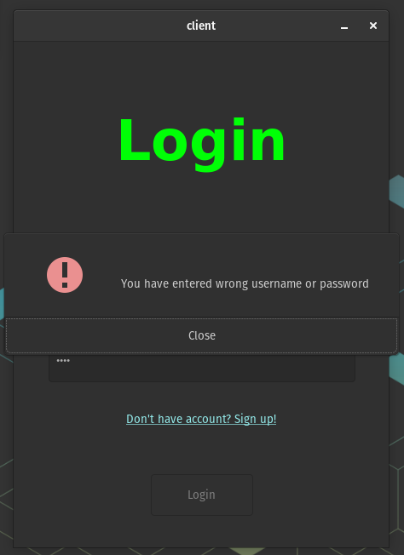
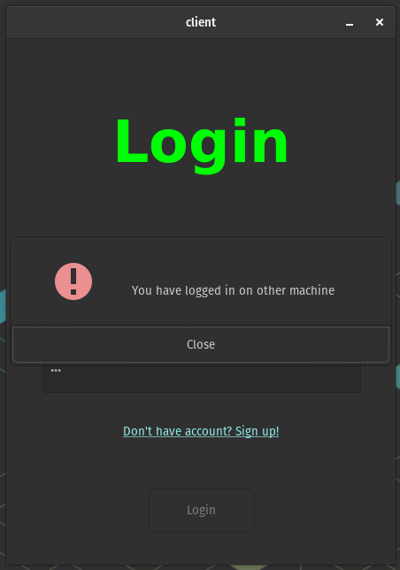
LOGIN FAILED dialog

Slide 29
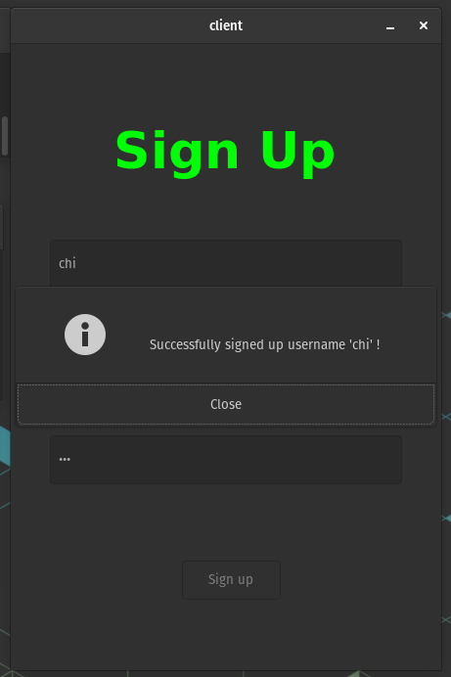
REGISTER SUCCESS dialog

Slide 30
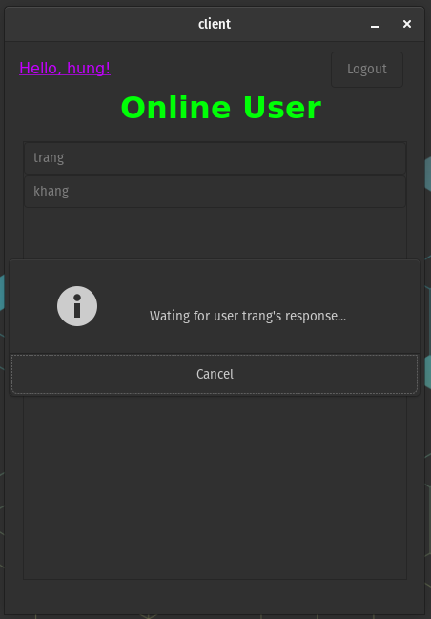
Request chat dialog

Slide 31
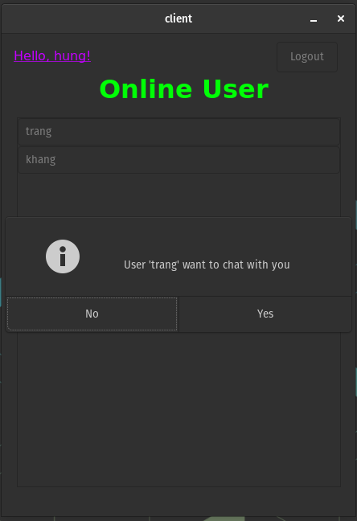
Receive request dialog

Slide 32
INDIVIDUAL CONTRIBUTION

Slide 33
Group member’s tasks

Slide 34
DEMO

Slide 35


Slide 36
THANKS !

